Slide 1
A Study of Tesla Motors
By
Lillian Asbury

Slide 2
Tesla’s information
Founded in 2003
Company name comes from Inventor Nikola Tesla
Their first motor that they invented was based off of Nikola Tesla’s patented induction motor
In 2017, they will launch their new car- The Model 3
The new car is supposed to have a base model price of $35,000

Slide 3
The Problem
Their goal is to become a car company that everyone can buy from
With more customers comes more issues
Their website is not user friendly- and there is not enough information on it
They do not have enough customer support on their website

Slide 4
Evaluation criteria
Cost
Productivity
Ease of Implementation
Timeliness
Cost refers to the amount of money that is needed for each option in order to fund it. Productivity refers to the rate of output and effectiveness from each individual option. Ease of implementation refers to the amount of difficultly that it will take to make the option into a viable reality. Timeliness refers to the amount of time needed to start and implement the option.

Slide 5
Option 1 – create a general support number & E-Mail
They have a set of help numbers in place
Hire new personnel
Add in a phone line

Slide 6
Option 2 – Set up live chat help on website
Live chat management companies available
Hire new personnel
Competitors use live chat

Slide 7
Option 3 – rearrange website & add more information
Already employ web service
Management already in place

Slide 8
Option Matrix

Slide 9
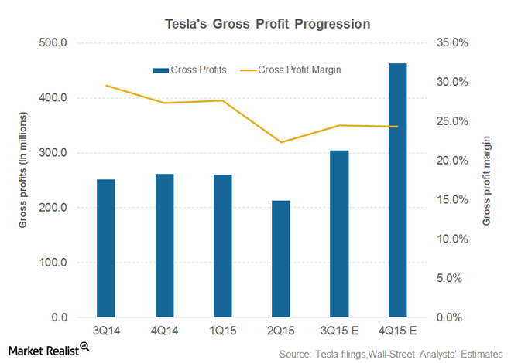
$1.8 Million 4th quarter in 2015
Over $700 million spend on R&D in 2015

Slide 10
My recommendation
All 3 recommended
Company has enough revenue
Enough time to employ all three

Slide 11
Questions? Comments?
Thank you!

